Slide 1





Quality of HIV-Care and Management – Benchmarking and Regional Differences across Europe
The convergence of the MDR-TB and HIV co-epidemics – global situation with focus on EE
Prof Jens Lundgren
CHIP, Rigshospitalet, University of Copenhagen
WHO Collaborative Centre on HIV, viral hepatitis and TB
Kamilla Grønborg Laut, MD
@ProfJLundgren

Slide 2
No commercial conflicts of interests relating to this presentation
Funding for TB-related research from European Commission (FP7) +
Danish National Research Foundation (grant no. 126)

Slide 3
Overlap for three conditions among high-burden countries
Global TB Report, 2017

Slide 4
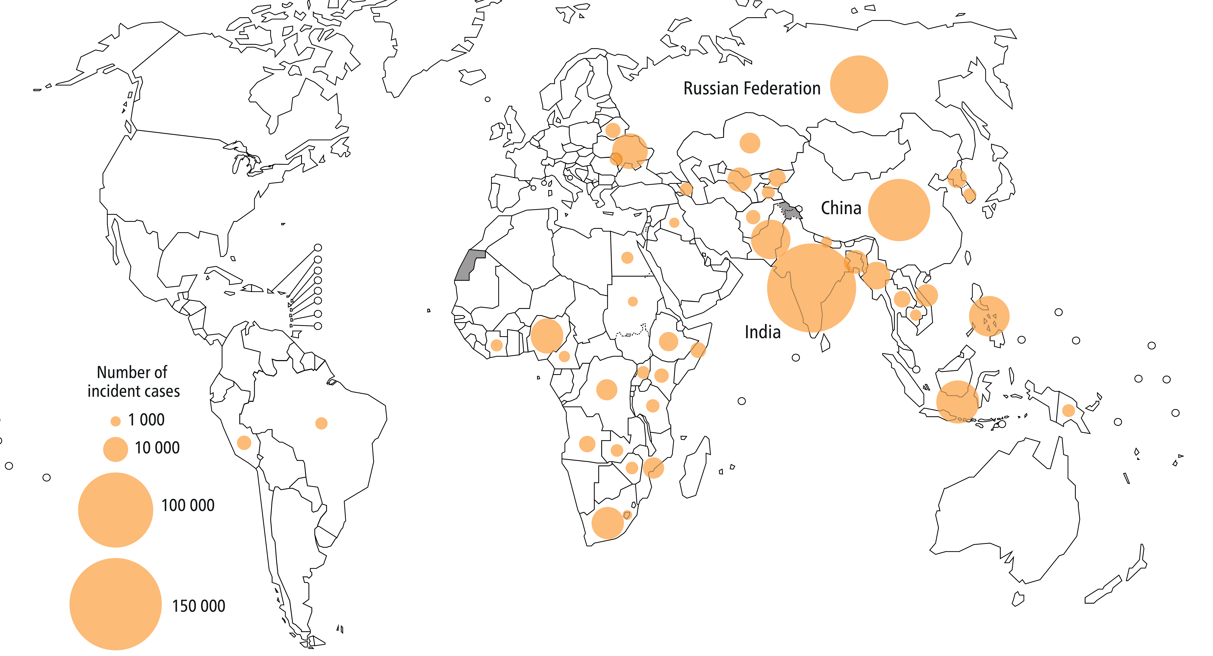
New MDR/RR TB cases in 2016
Global TB Report, 2017

Slide 5
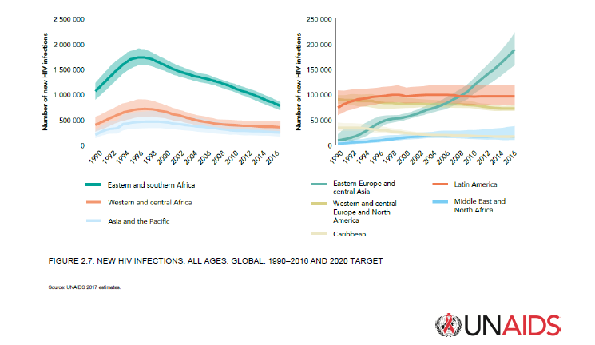
Alarming rise in new HIV infections in Eastern Europe and Central Asia
Notes:
Annual increase by 60%
EECA is now the only region where the number of new HIV infections has increased annualy from 120.000 to 190.000 between 2010 and 2015. Resulting in the number of people with HIV increasing from 1.0 mln to 1.5 mln in the same period. This is the only region in the world, where HIV epidemic continues to expand fastly

Slide 6
Estimated HIV prevalence among TB cases, WHO European Region, 2006-2016
13,5% average annual growth of HIV prevalence between 2006 and 2016.
Regional estimate was revised following Epi-review in Russia in 2017.

Slide 7
WHO European Region has fastest decline in TB incidence, but…still growing TB/HIV co-infection
-5.0% annual decline between 2012-2016
8.7% annual increase between 2012-2016

Slide 8
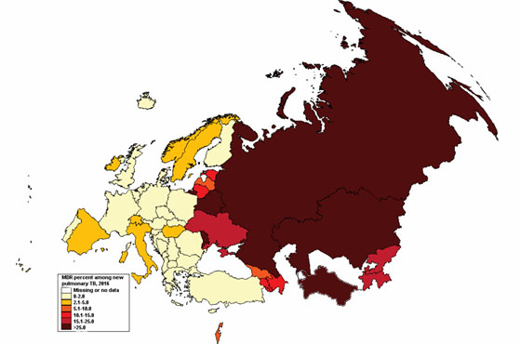
Percentage of notified TB cases with multidrug resistance among new pulmonary cases, European region, 2016
8 countries reported MDR prevalence over 20% among new pulmonary tuberculosis cases

Slide 9
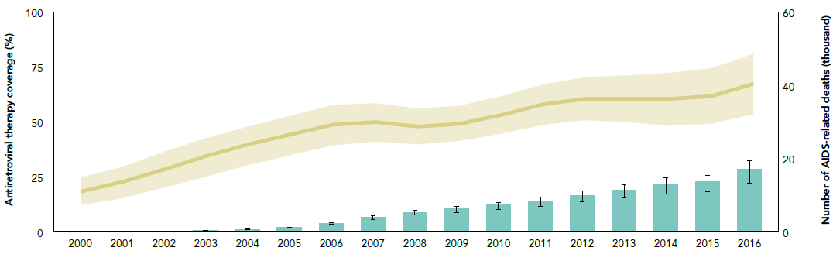
ART coverage and AIDS related deaths, Eastern Europe and central Asia 2000-2016
40,000
27%
Source: UNAIDS. Global AIDS Update 2017.
Notes:
The limited progress in EECA is not sufficient to revert the increasing AIDS mortality trend (a 25% increase in estimated deaths over the last six years alone, 2010-2016).
This is driven by a combination of factors: 1/3 (37%) undiagnosed PLHIV, low ART coverage (28% of all PLHIV, diagnosed and undiagnosed are receiving treatment) and increasing HIV incidence – factors that are all contributing to this continuing (and unacceptable) increasing trend in AIDS mortality.

Slide 10
HIV treatment coverage by country eastern Europe and central Asia, 2016
Source: UNAIDS. Global AIDS Update 2017.

Slide 11
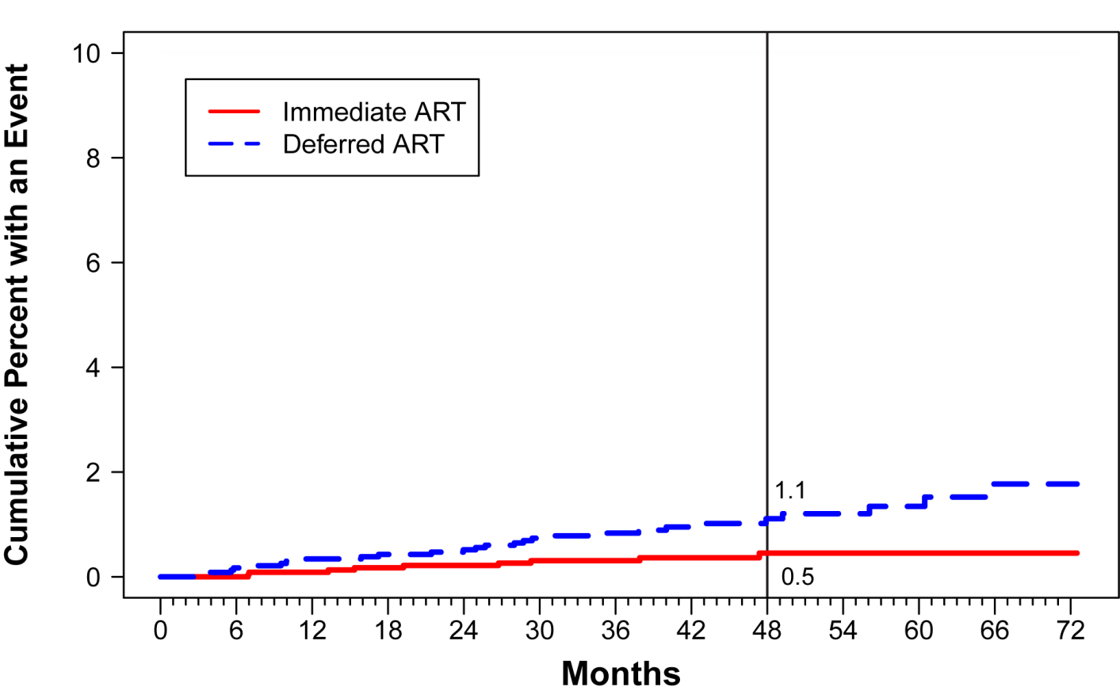
Time to first tuberculosis event in START
(immediate vs deferred ART in early HIV infection)
INSIGHT START study group: Lundgren et al, NEJM 2015
11

Slide 12
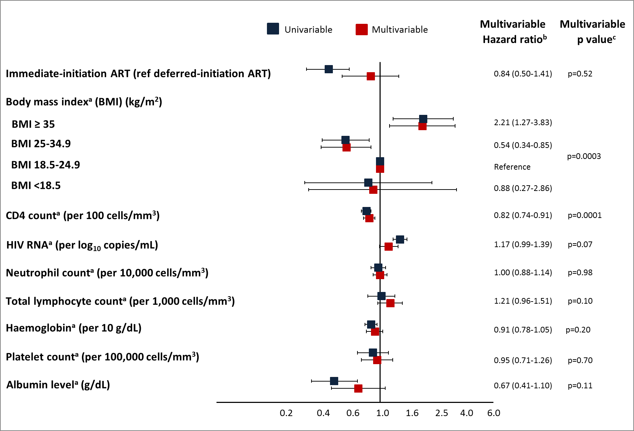
Risk of serious invasive bacterial infections
 | # of Participants
Type of event | Imm. ART | Def. ART
Bacterial pneumonia | 14 | 34
TB | 6 | 20
Others | 14 | 36
Total | 34 | 90
Attenuation
due to
CD4+
adjustment
* Time-updated covariate.
INSIGHT START study group: O’Connor et al, Lancet HIV 2017
Notes:
This Figure presents both univariable and multivariable hazard ratios (HRs) and 95% CIs for a selection of factors that were included in the Cox model. In univariable analysis immediate-initiation ART was associated with a reduced risk of SBI (HR 0.41, 95% CI 0.27–0.65, p<.0001). However, in multivariable analysis (after adjustment for all covariates listed in the methods) the HR was no longer significantly below one (HR 0.75, 95% CI 0.42–1.32, p=0.30). Adjustment for time-updated CD4 count in the multivariable model was responsible for the attenuation of the HR for treatment group.
In multivariable analysis a BMI above 35 kg/m² (HR 3.38, 95% CI 1.74–6.57, p<.0001) was associated with an increased risk of SBI when compared to a reference group of a BMI between 18.5 and 24.9 kg/m². Higher time-updated CD4 count (HR per 100 cells/mm³ 0.83, 95% CI 0.74–0.92, p=0.0004) was associated with a reduced risk of SBI. Time-updated neutrophil count was not associated with risk of SBI (HR per 10,000 cells/mm³ 0.94, 95% CI 0.20–4.32, p=0.96). Other factors that were included in the multivariable model but were not associated with SBI include age (p=0.17), sex (p=0.24), race (p=0.14), smoking status (p=0.34), mode of HIV infection (p=0.48), time since HIV diagnosis (p=0.82), hepatitis B (p=0.93) and hepatitis C status (p=0.43), HIV RNA viral load (p=0.46), total lymphocyte count (p=0.09), hemoglobin (p=0.66), platelet count (p=0.55), and albumin level (p=0.43).

Slide 13
Impressive decline in TB mortality combined with growing burden of TB/HIV mortality
-8.3% annual decline between 2010-2016
4.9% annual increase between 2010-2016

Slide 14
TB treatment results by HIV status
WHO Europe/ECDC Tuberculosis surveillance and monitoring in Europe 2017
A. Dadu, WHO Europe: personal communication

Slide 15
Organisational set-up of TB services in Eastern and Western Europe - survey
% of participating clinics
  All p<0.001; OST: opiate substitution therapy
M Mansfeld et al, HIV Med 2015

Slide 16
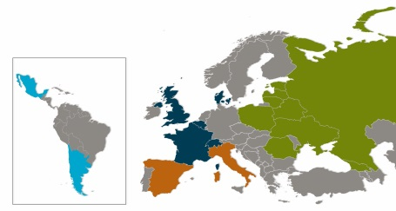
HIV/TB study:
Diagnosis of TB and availability of DST results
N=1406
p < 0.0001
Region
Efsen et al. Plos One 2015

Slide 17

HIV/TB study:
Projected initial anti-TB treatment efficiency
(DST results became available thereafter)
N=1406
Eastern Europe
N=298/830
Western Europe
N=94/151
Southern Europe
N=104/162
Latin America
N=89/253
N of active drugs in the initial anti-TB treatment according to the results of resistance test
AM. Efsen et al. Plos One 2015

Slide 18
Antiretroviral treatment in Eastern Europe
45% (35%-52%) of people leaving with HIV who know there status are on treatment
UNAIDS report 2017
Of 27.000 estimated TB/HIV cases about
  16.500 (61%) were detected
    5800 (35%) were offered antiretroviral treatment
WHO Europe/ECDC Tuberculosis surveillance and monitoring in Europe 2017
A. Dadu, WHO Europe: personal communication

Slide 19
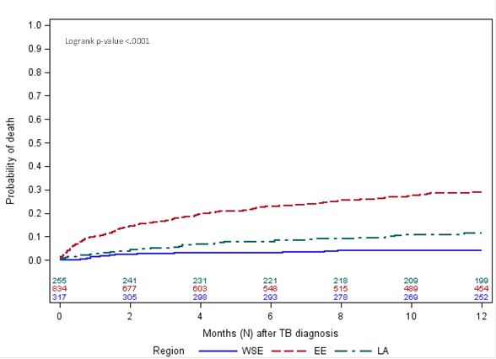
TB/HIV study:
Mortality among TB/HIV patients according to region of residence
Eastern Europe
Latin America
Western/Southern Europe
N=1406
Deaths from TB:
EE: 79%
LA: 36%
WSE: 23%
Podlekareva & Efsen et al. Lancet HIV 2016

Slide 20
Shorter course MDR-TB regime
Achieve high treatment success rates (87–90%) in selected MDR/RR-TB patients
  % eligible*
    European region: 8%
    Eastern European region: 4%
    EU: 11%
    Brazil / Pakistan: 50-55%
    SouthEast Asia: 30%
Access to newer anti-TB drugs
  Bedaquiline
    Used in 89 countries (75% of patients are from Russia and SA)
  Dalamanid
    Used in 54 countries
*Lange, Respirology 2018 + AJRCCM 2016; Balabanova Thorax 2017; van der Werf + Dalcolmo+ Javiad+Chee ERJ 2017

Slide 21
Summary – convergence of MDR-TB and HIV
Highest MDR case load: India, China and Russia
Prevalence of MDR-TB among TB cases highest in Russia and nabouring countries
  Epidemic transmission of HIV
  Low ART coverage
    Large population of ART naive HIV+ immune impaired patients allowing fast transition from TB infection to active TB (incl MDR)
  Drug susceptibility testing (DST): 1/3 of TB/HIV cases
  If DST: 1/3 starts with < 2 active TB medications
  <10% fulfill criteria for WHO-recommended ”short-term”
Focus areas
  Scale up ART coverage – strengthen all aspects of CoC
  Better coverage of DST – incl 2nd line TB drugs
  New and novel 2nd line drugs – motto ”protect them”
  New strategies to ”practically” prevent & treat MDR/XDR TB

Slide 22

Acknowledgements
WHO-E: Masoud Dara; Elena Vovc, Annemarie Stengaard, et al
ECDC: Teymur Noori, Anastasia Pharris, Andrew Amato, et al
Dedicated colleagues across the continent working hard to prevent HIV and TB transmission and improve health in their setting
CHIP/WHO Collaborative centre for HIV, TB and viral hepatitis: Dorthe Raben, Anne Raahauge, Daria Podlekareva, Ole Kirk, et al

Slide 23
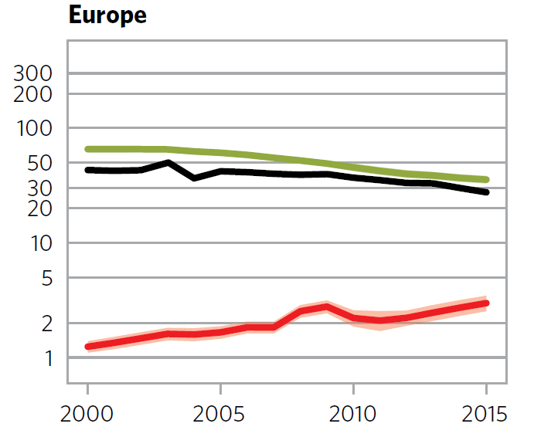
Trends in estimated TB incidence rates 2000-2015 per 100.000 per year (log scale)
TB incidence: 4,5% annual decline
Total TB cases
TB/HIV incidence: 6,2% annual increase
HIV+ TB cases
WHO global tuberculosis report 2016
A. Dadu, WHO Europe: personal communication
Notes:
So, now we will look at trends of TB and HIV coinfection, while European Region has fastest decline in TB incidence, the epidemic of TB/HIV co-infection is still growing
TB incidence: 4,5 annual decline between 2010 – 2015
TB/HIV incidence: 6,2% annual increase 2010 - 2015

Slide 24
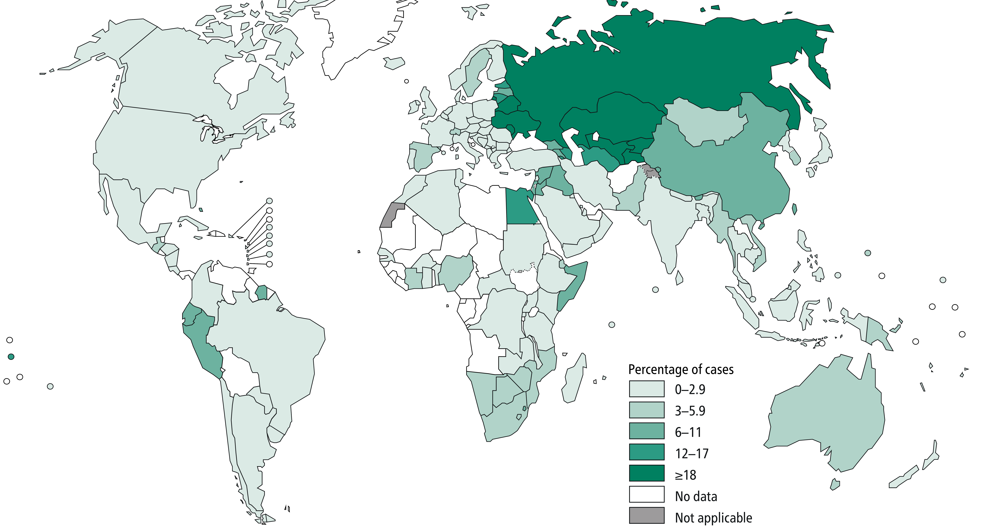
Prevalence of MDR/RR among new TB
Global TB Report, 2017

Slide 25
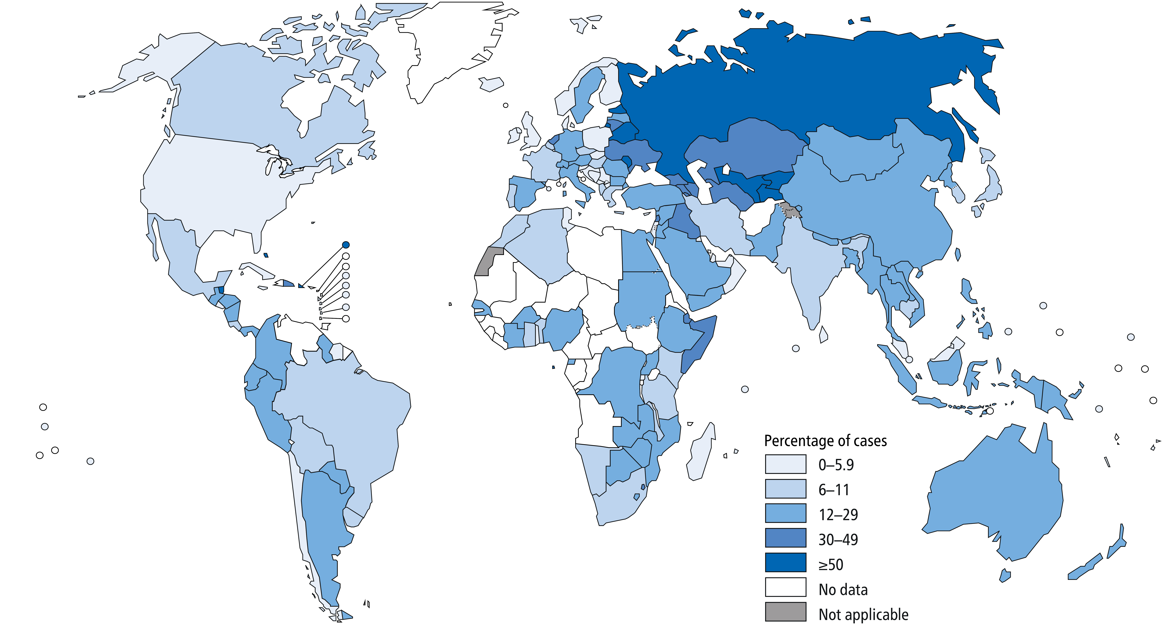
Prevalence of MDR/RR among recurrent TB
Global TB Report, 2017

Slide 26
HIV prevalence among new and relapse TB, 2016
Global TB Report, 2017

Slide 27
Trend of MDR-TB notification rate per 100,000 population in WHO European region and 18 HPCs, 2012-2016
Notes:
HPC: High priority countries

Slide 28
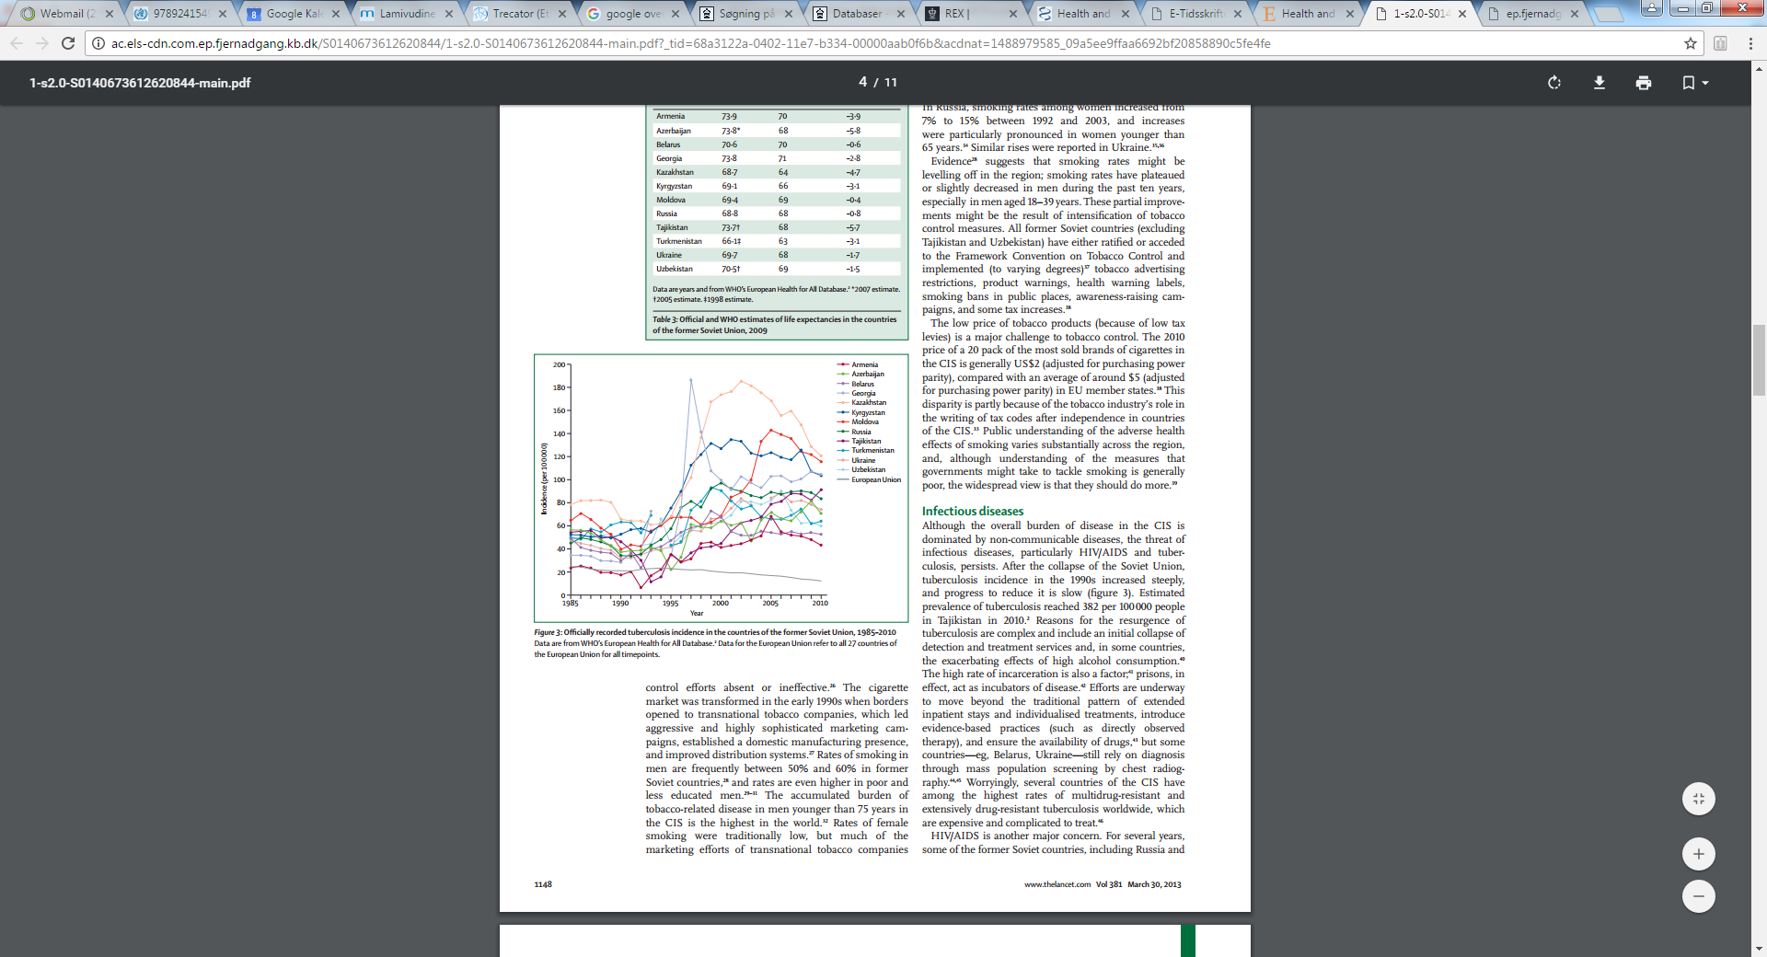
TB incidence in the former Soviet Union
Rechel et al. Lancet 2013
Notes:
Now we go a little bit back in history and look at TB epidemic in Eastern Europe before and after 1990.
During 20th century EE experienced several increases and declines in TB epidemic.
Since ~1970 a rapid decline in TB incidence was observed due to well organised Phthisiology service and TB control
However, efter colaps of Soviet Union in 1991, we observe an immense increase in TB incidence and prevalence since in all former SU countries

